Slide 1

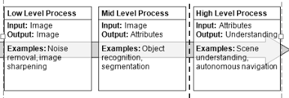
Digital Image Processing
6-discuss the different categorizes for DIP operations
(Low level processes, medium level processes, high level processes)
giving an example for each category

Slide 2

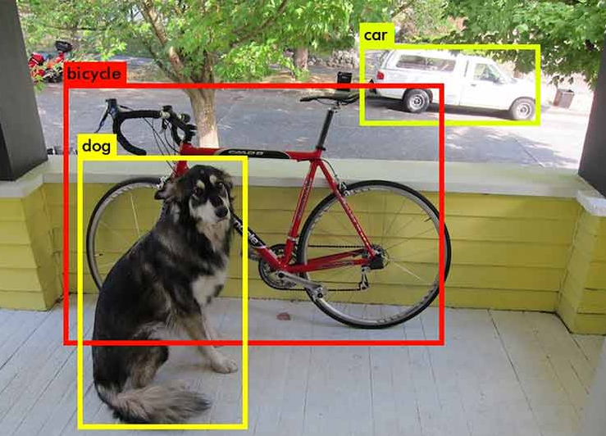
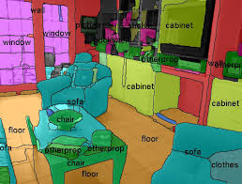
Digital Image Processing
6-discuss the different categorizes for DIP operations
(Low level processes, medium level processes, high level processes)
giving an example for each category

Slide 3
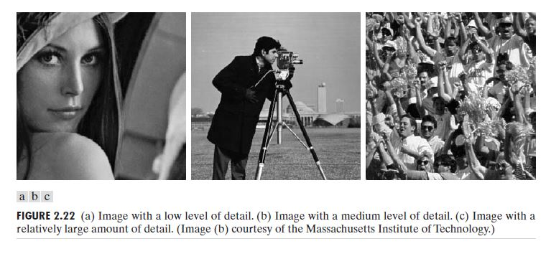
Digital Image Processing
6-discuss the different categorizes for DIP operations
(Low level processes, medium level processes, high level processes)
giving an example for each category

